Slide 1
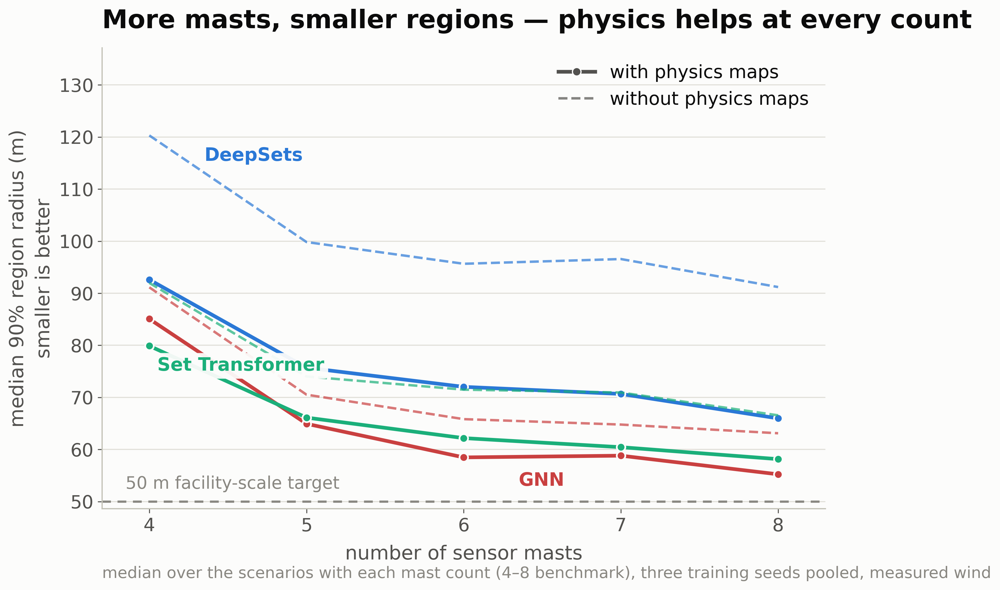
More sensor masts shrink the localization region, with the largest gains from four to six masts and diminishing returns beyond. At every sensor count, the physics-guided models produce smaller regions than their baselines.

